Slide 1
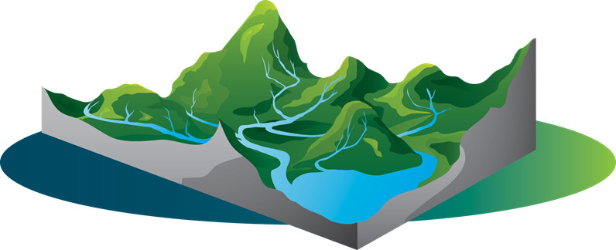
Study Of Watershed And Sites Suitability For Water Harvesting Structures Jawahar Taluka
Under the guidance of
Prof Pennan Chinnasamy
PhD Scholars:
Meeta Gupta
Neetu Singh
Pranadh
Gokul Prasad
Submitted by,
Pavan Muttepawar (ID: 245685)

Slide 2
Motivation:
Jawhar taluka is having precipitation above 2000mm even though at the beginning of January, many of the streams are dry and people are facing water scarcity. This project tries to study on the solution of the water crisis.
Methodology for DEM:
Selected QGIS Grass
Files are downloaded in SRTM file
Raster>Miscelleneous- Merge- Setted o/p data file same as input data file
Reprojection- raster- projection, open osm
For fill: Toolbox > use grass >hfill.dir- dimensionless (Used properties single band)
Flow direction: (Elevation surface- flow direction then comes flow accumulation)
Flow direction> r.watershed
Select filldem> basin min size- 500, enabled D8> only checked accumulation and direction
Flow direction absolute value.
Channels in accumulation
Stream extraction- used r.stream.extract> use fill dem> minimum flow o/p=5000, v.out.ogro o/p- line, Unique strea ids= stream network
Delineate= I/p given is direction correction, r to vect
Vector> geo-processing clip> stream network > catchment
Objectives of the study:
1) Understanding the watershed of the area in water security perspective.
2) Finding Suitable sites for water storage structure in the watershed.
Methodology:
In order to accomplish the objective of the project following entities are calculated.
1. Watershed delineation.
2. Finding Suitable sites for water storage structure in the watershed.

Slide 3
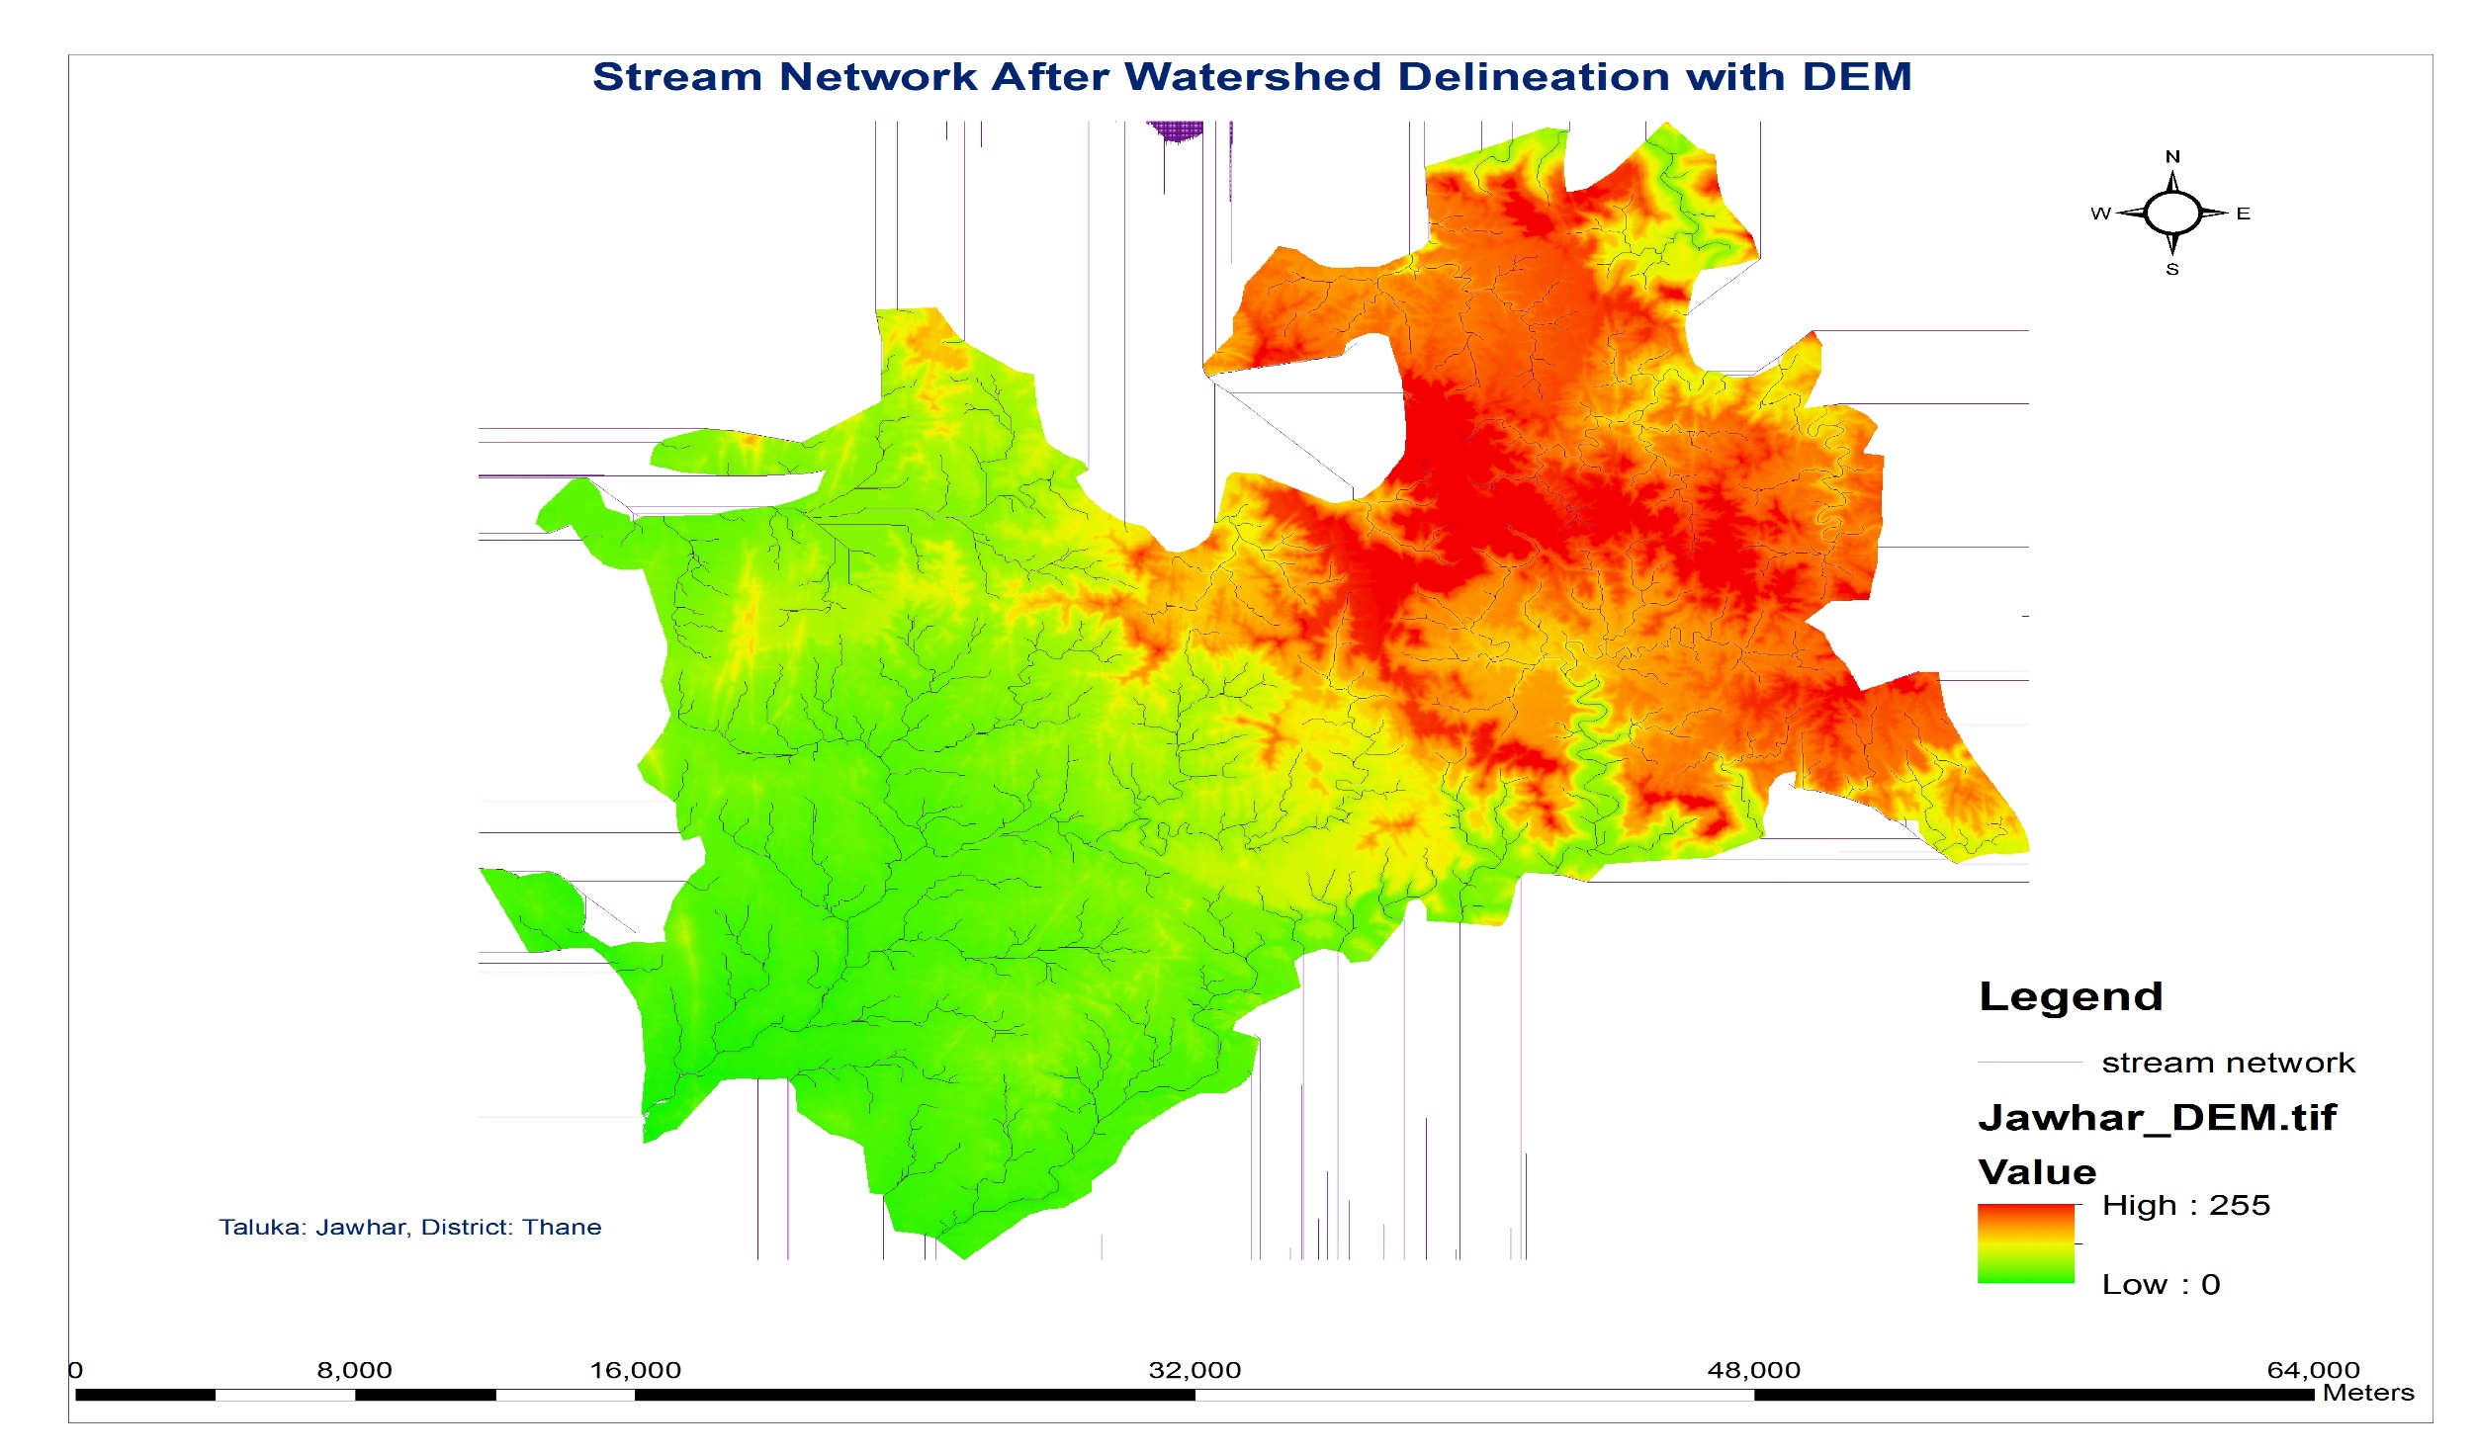

Slide 4
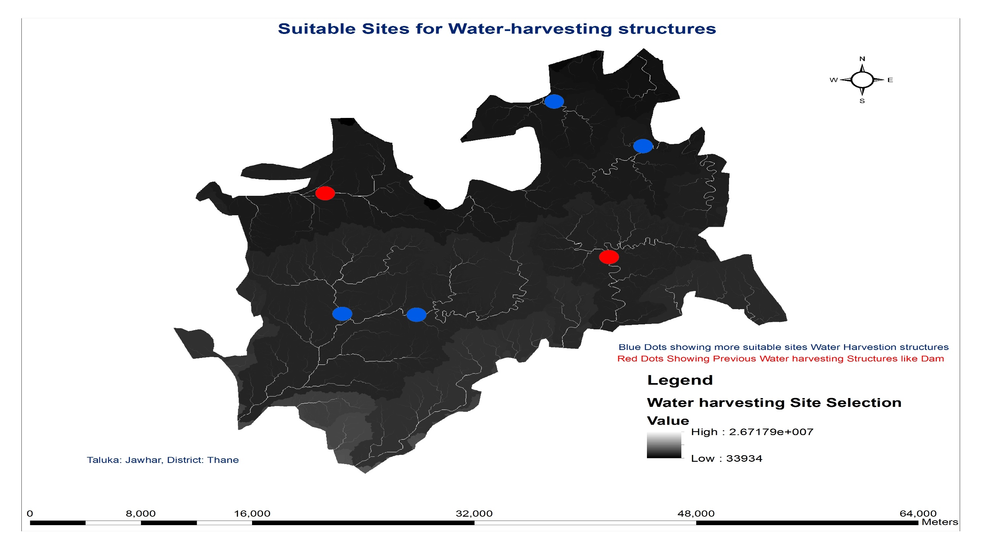
2) Findings suitable sites for water storage structure in the watershed:
Parameters Used:
Stream network
DEM
Flow Accumulation
Attempted NDVI
Basin
Slope
Limitation: Approximately considered suitable sites by delineation model, attempted NDVI and observation on maps and google earth

