Slide 1
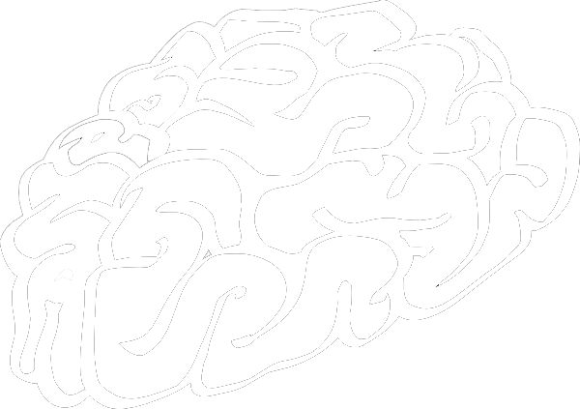
Exploratory data analysis of youtube, feat.
The scipy stack

Slide 2
Who are we?
procrasti..

Slide 3
What do we solve?

Slide 4
THE YOUtube
seo
Algorithms used.
Parameters Considered.
Our Research.

Slide 5
It’s all about the tags.

Slide 6
Knowing the data

Slide 7
I give up. I can’t make slides anymore, LET’s see some code.

Slide 8
Few valuable insights later...
We can conclude that...
The video trends a few days later.
Tags are strongly correlated to views.

Slide 9
Future
SCOPE
Tag prediction using Natural language processing.
Web portal for all the budding youtubers.
Finding some more insights because data knows everything.

Slide 10
A special thanks to, Python

Slide 11
Thank You.
Presented by,
Abhishek Jha,
Pratik Deshpande.

Slide 12
QUESTIONS?

